Slide 1
<creation out of thin air>
By:
<kasra amini yeganeh>
<Aryana seyed peyrovy>

Slide 2
So what does it do ?
Creations
Entertainments
To be explored!!!
Image Transformations
Applications

Slide 3
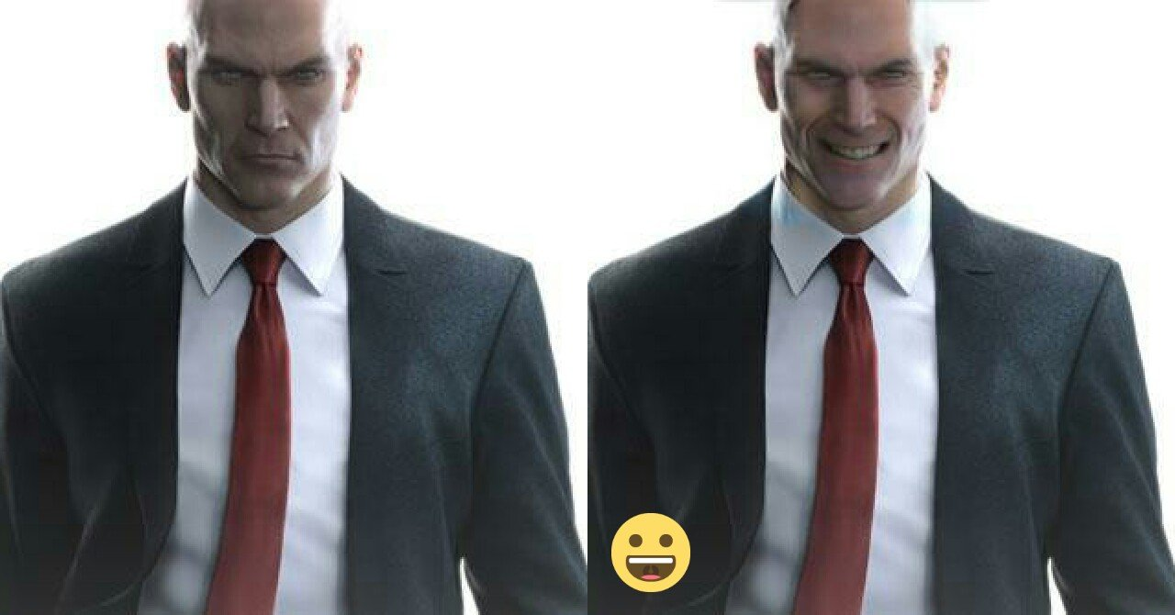
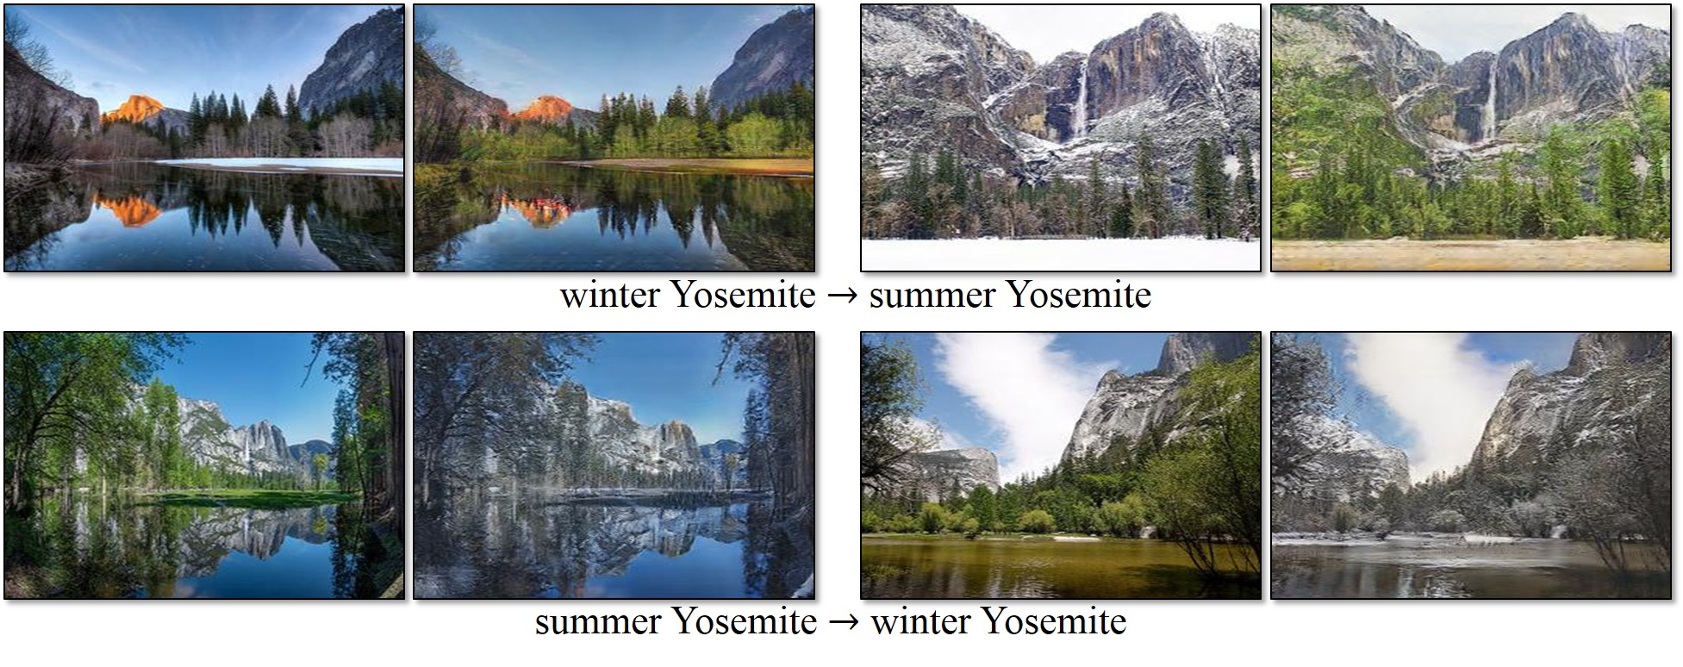
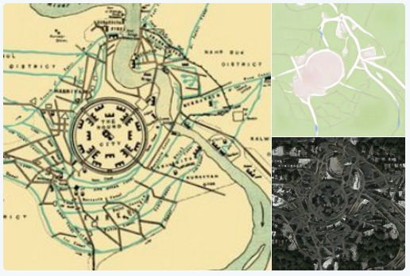
Some use cases:

Slide 4

More applications:

Slide 5
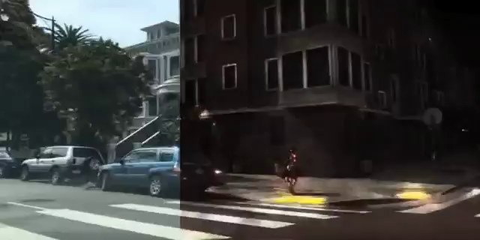

Slide 6
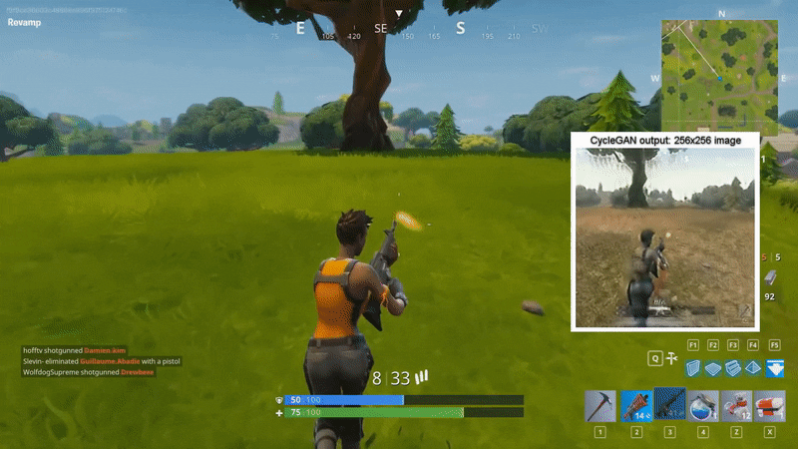

Slide 7
Background Information
What are GANs and what are they good for ?
Generative adversarial networks (GANs) are deep neural net architectures comprised of two nets, pitting one against the other (thus the “adversarial”).
GANs were introduced in a paper by Ian Goodfellow and other researchers at the University of Montreal in 2014.
GANs’ potential is huge, because they can learn to mimic any distribution of data. That is, GANs can be taught to create worlds eerily similar to our own in any domain: images, music, speech, prose. They are robot artists in a sense.
Generative vs. Discriminative Algorithms
discriminative algorithms map features to labels. They are concerned solely with that correlation. One way to think about generative algorithms is that they do the opposite. Instead of predicting a label given certain features, they attempt to predict features given a certain label.
Another way to think about it is to distinguish discriminative from generative like this:
Discriminative models learn the boundary between classes
Generative models model the distribution of individual classes

Slide 8
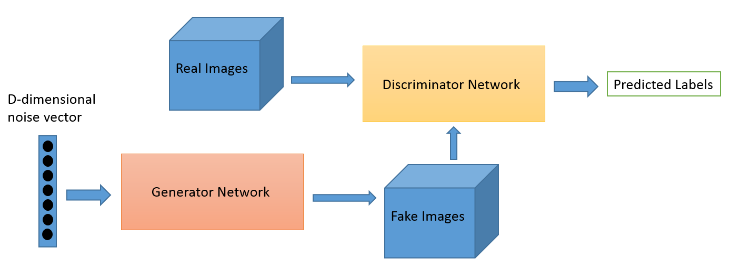
Background Information
How GANs Work
One neural network, called the generator, generates new data instances, while the other, the discriminator, evaluates them for authenticity; i.e. the discriminator decides whether each instance of data it reviews belongs to the actual training dataset or not.
Here are the steps a GAN takes:
The generator takes in random numbers and returns an image.
This generated image is fed into the discriminator alongside a stream of images taken from the actual dataset.
The discriminator takes in both real and fake images and returns probabilities, a number between 0 and 1, with 1 representing a prediction of authenticity and 0 representing fake.

Slide 9
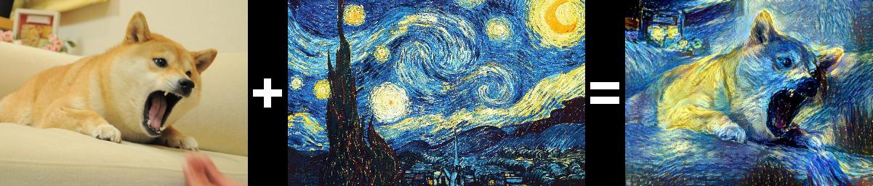
So what’s the big deal?
CycleGANs
Transferring characteristics from one image to another is an exciting proposition.
The paper we are going to implement is titled "Unpaired Image-to-Image Translation using Cycle-Consistent Adversarial Networks".
Cycle-Consistent
The previous adversarial method of training has a problem though. Quoting the authors of the original paper:
Adversarial training can, in theory, learn mappings G and F that produce outputs identically distributed as target domains Y and X respectively. However, with large enough capacity, a network can map the same set of input images to any random permutation of images in the target domain, where any of the learned mappings can induce an output distribution that matches the target distribution.
Thus, an adversarial loss alone cannot guarantee that the learned function can map an individual input xi to a desired output yi.

Slide 10
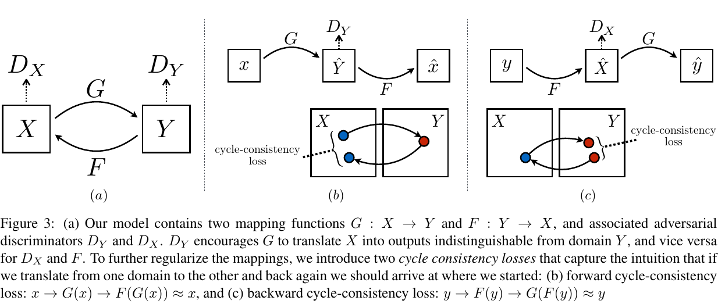
What does cycleGAN do

Slide 11
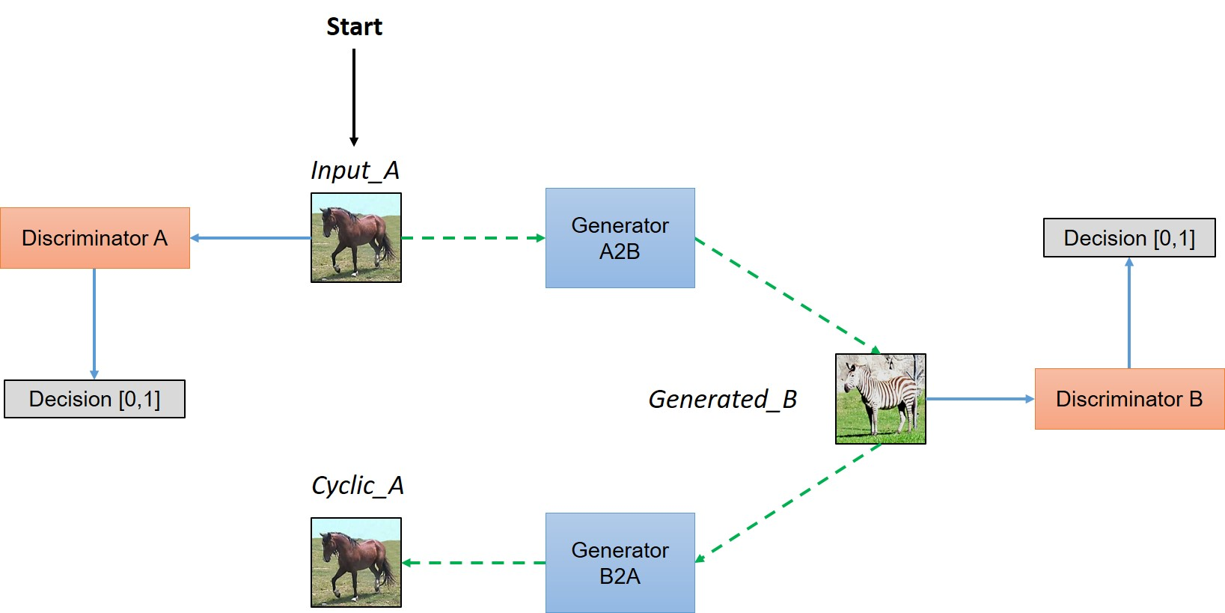
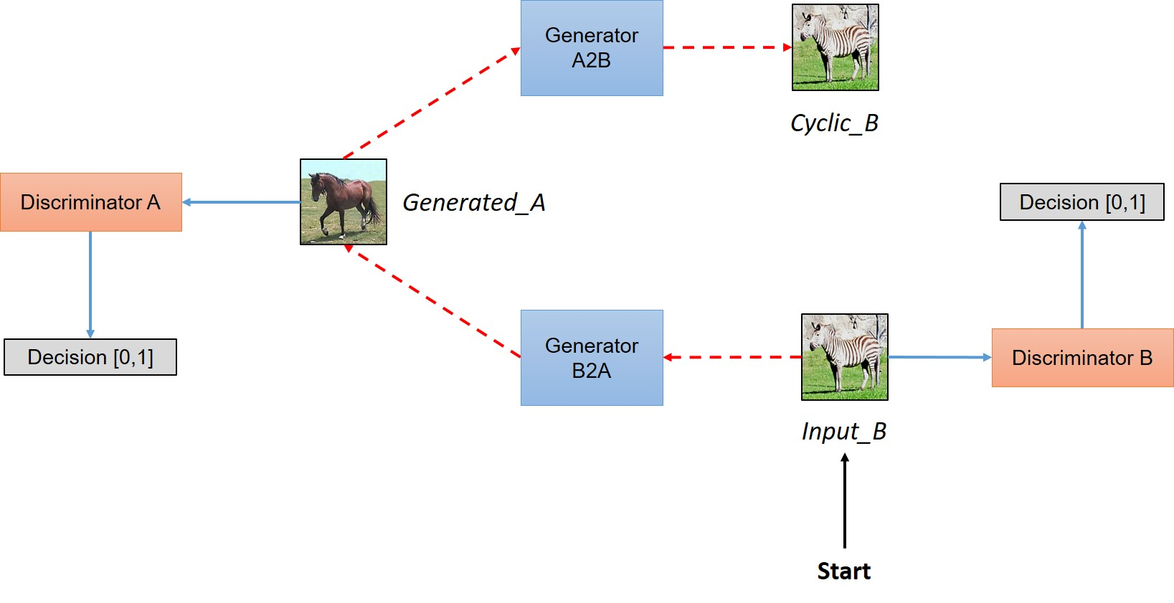
Network Architecture

Slide 12
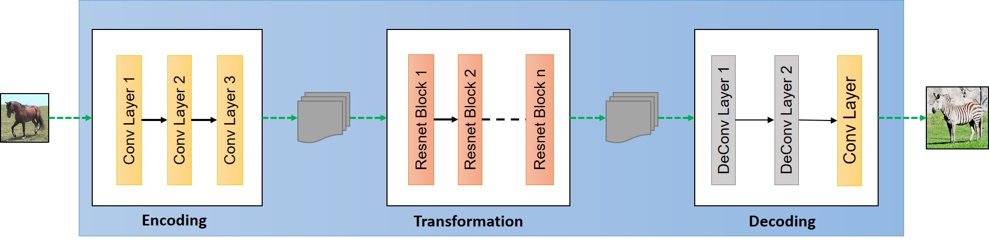
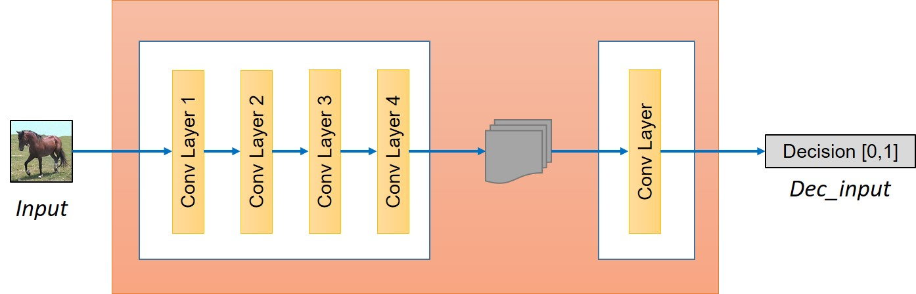
Building the generator
High level structure of Generator can be viewed in the following image.
BUILDING THE DISCRIMINATOR

Slide 13
Loss functions
MSE
MAE

Slide 14
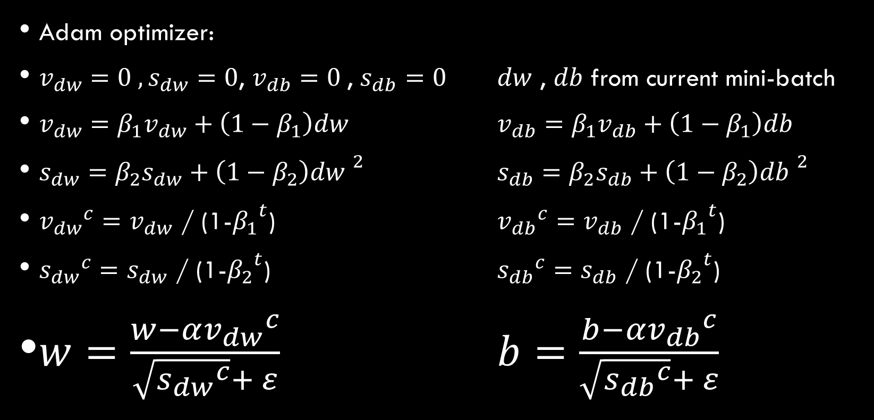
Optimizer
Adam optimizer:
, , , from current mini-batch
/ (1-) / (1-)
/ (1-) / (1-)

Slide 15




Technologies used :
python
Colab
Techs
Keras
Tensorflow

Slide 16
Our Challenges
Lack of proper dataset
Lack of proper GPU
Fairly hard Concepts

Slide 17
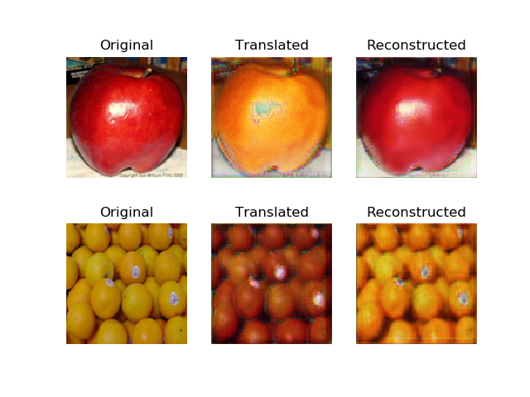
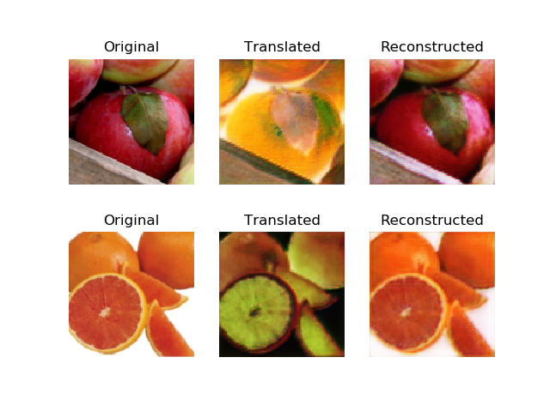
Results of 30 epochs(apple2orange dataset)

Slide 18
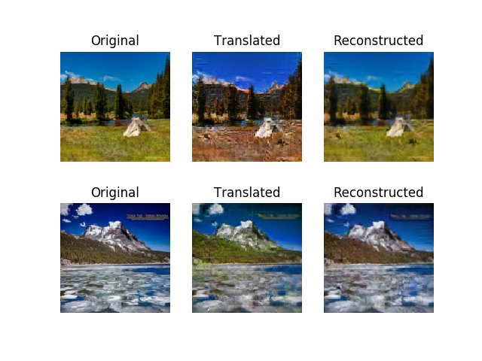
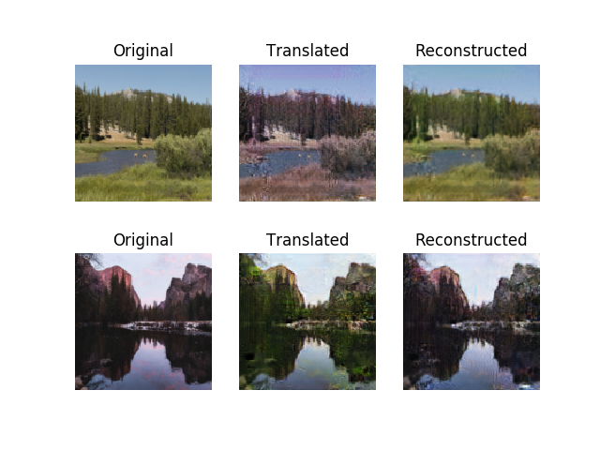
Even more!!! 140 epochs(summer2winterdataset)

Slide 19
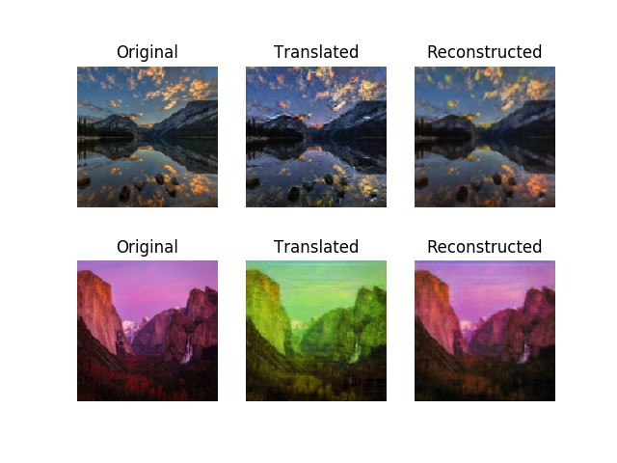
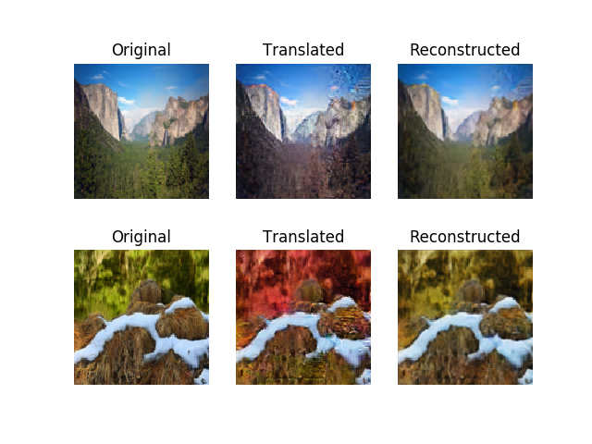

Slide 20
Result accuracy

Slide 21
references
Unpaired Image-to-Image Translation using Cycle-Consistent Adversarial Networks Jun-Yan Zhu* Taesung Park* Phillip Isola Alexei A. Efros UC Berkeley https://junyanz.github.io/CycleGAN/
Andrew NG videos https://www.youtube.com/watch?v=JXQT_vxqwIs
https://github.com/eriklindernoren/Keras-GAN

